Slide 1
Deep Learning Project
Objective
Classify dog and cat breeds from a photograph with maximum accuracy.
Oxford-IIIT Pet Dataset
Fine-grained image classification of 37 pet breeds using deep learning — from a custom CNN baseline to state-of-the-art transfer learning models.
Project Structure
📊 Dataset + EDA
🧱 CNN Baseline
🔄 ResNet18
37 Breeds
7,400 Images
PyTorch
Transfer Learning
⚡ ConvNeXt-Tiny
🤖 ViT
📊 Results Comparison
🚀 Classification App
Deep Learning Bootcamp 2026 • Ironhack
Marcelo Correia, Benay Gavazoglu & Don Mithila Palliya Guruge

Slide 2
Project Roadmap
Project overview — phase by phase
1
2
3
4
5
6
7
8
Dataset
+ EDA
CNN
Baseline
ResNet18
ConvNeXt
Tiny
ViT
Comparisons
Conclusions
App
Phase 1 — Data
Phase 2 — Baseline
Phases 3-5 — Transfer Learning
Phases 6-8 — Analysis & App
Exploratory analysis of the Oxford-IIIT Pet dataset: 37 breeds, 7,400 images, balanced distribution.
CNN trained from scratch to establish a performance baseline before transfer learning.
Progressive application of pre-trained models: ResNet18, ConvNeXt-Tiny, and Vision Transformer.
Comparison of all models, conclusions, and deployment of a classification application.

Slide 3
Dataset + EDA
Oxford-IIIT Pet Dataset — Fine-Grained Classification
7,400
37
~200
Balanced
Total Images
Breeds (25🐕 + 12🐈)
Images per Class
Class Distribution
Why is it challenging?
Input Normalization
High visual similarity between breeds
Variation in pose, lighting, and background
Only ~200 images per class
Subtle differences between classes (fine-grained)
Official train / val / test split applied
Statistics computed on the training set:
Channel R
Mean: 0.478
Std: 0.263
Channel G
Mean: 0.446
Std: 0.258
Channel B
Mean: 0.396
Std: 0.265
Applied consistently to train, val, and test

Slide 4
CNN Baseline — Architecture
Convolutional network trained from scratch
Input
160×160
Conv Block 1
+BN+ReLU+Pool
Conv Block 2
+BN+ReLU+Pool
Conv Block 3
+BN+ReLU+Pool
Conv Block 4
+BN+ReLU+Pool
GAP
+Dropout 0.4
FC
37 classes
Training Configuration
Architecture Detail
Optimizer
AdamW (lr=0.001, weight_decay=5e-4)
Conv Block
Conv2d→BN→ReLU→Conv2d→BN→ReLU→MaxPool
Schedule
Warmup 5ep + Cosine Annealing LR
4× blocks
Growing channels per block
Epochs
100
GAP
Global Average Pooling (anti-overfit)
Batch size
32
Dropout
p=0.4 before the final layer
Loss
CrossEntropy
Output
FC Linear → 37 classes
Regulariz.
Dropout p=0.4 + BatchNorm
Params
~0.5M trainable parameters

Slide 5
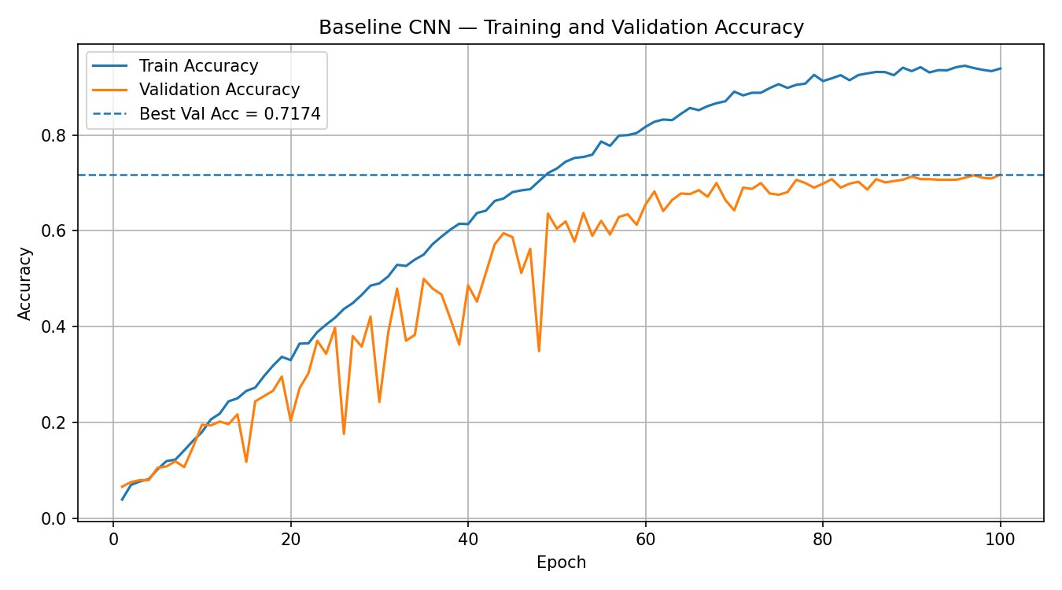
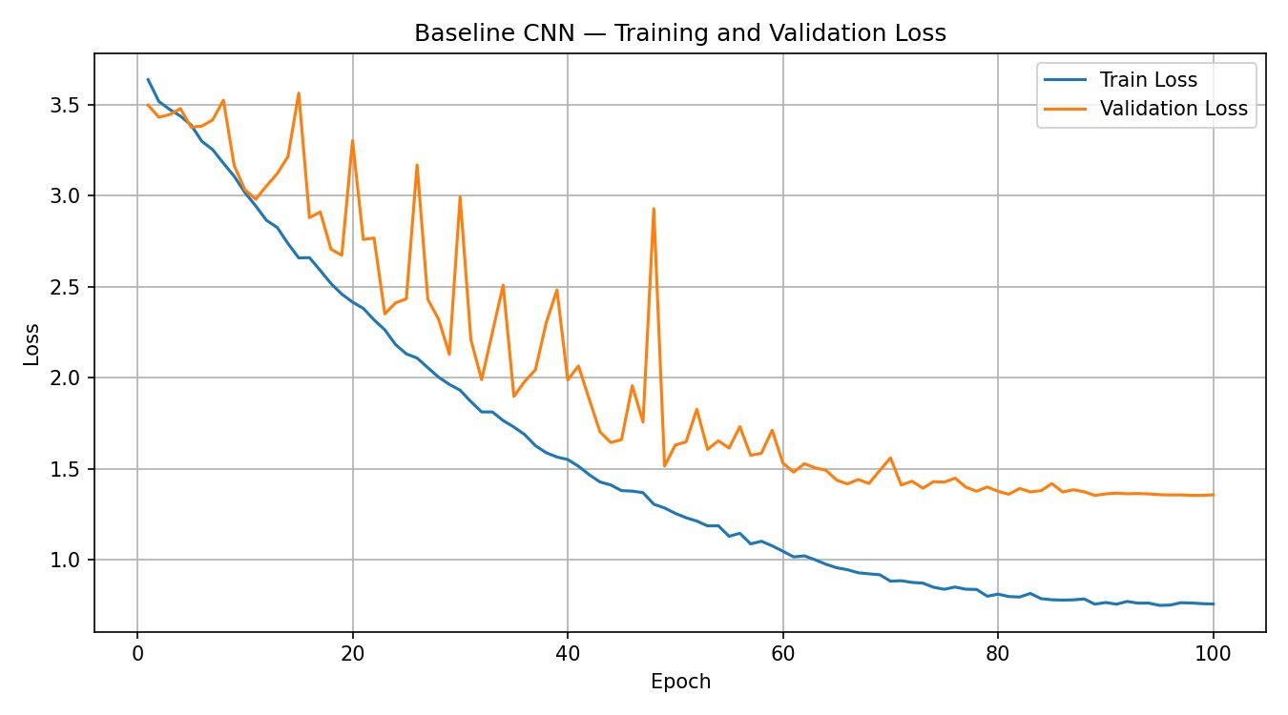
CNN Baseline — Training Curves
100 epochs · trained from scratch · IMG_SIZE 160

Slide 6
CNN Baseline — Results
100 epochs · custom CNN from scratch
71.74%
62.25%
9.49 pp
Best Val Accuracy
(Epoch 100)
Test Accuracy
Generalization Gap
(overfit)
Training Curves — Observations
Ablation Experiments
Val accuracy rises consistently until epoch 83
After that, overfitting begins — train rises, val stagnates
Train/val gap of 9.49 pp confirms moderate overfitting
Training loss converges but val loss diverges slightly
Expected for a CNN from scratch with ~200 imgs/class
Configuration
Test Acc
Note
Baseline (100 ep.)
62.25%
✅ Best
EXP1 — ref 30 ep.
35.70%
Base ref
EXP2 — lr=0.0001
24.83%
Slow
EXP5 — no BN
2.73%
💀 Collapse
EXP6 — heavy aug
25.16%
Underfit
🔑 BatchNorm is critical — without it the model collapses to 2.73%. Dropout and 100 epochs are essential for generalization.

Slide 7
ResNet18 — Architecture
Pre-trained on ImageNet — fine-tuned on Oxford Pet
Input
224×224
Layers 1–2
frozen
Layer 3
frozen
Layer 4
fine-tuned
GAP
AdaptivePool
Linear
37 classes
Training Configuration
Architecture Detail
Optimizer
AdamW (lr=1e-4, weight_decay=1e-4)
ResNet Block
3×3 Conv → BN → ReLU (with skip conn.)
Schedule
ReduceLROnPlateau
4 stages
64 → 128 → 256 → 512 channels
Epochs
20
GAP
Global Average Pooling before classifier
Batch size
16
Dropout
No dropout (weight_decay=1e-4)
Loss
CrossEntropy
Output
Linear(512, 37) — replaced head
Regulariz.
Fine-tune layer4 + fc only
Params
~11.7M total, 512 frozen layers

Slide 8
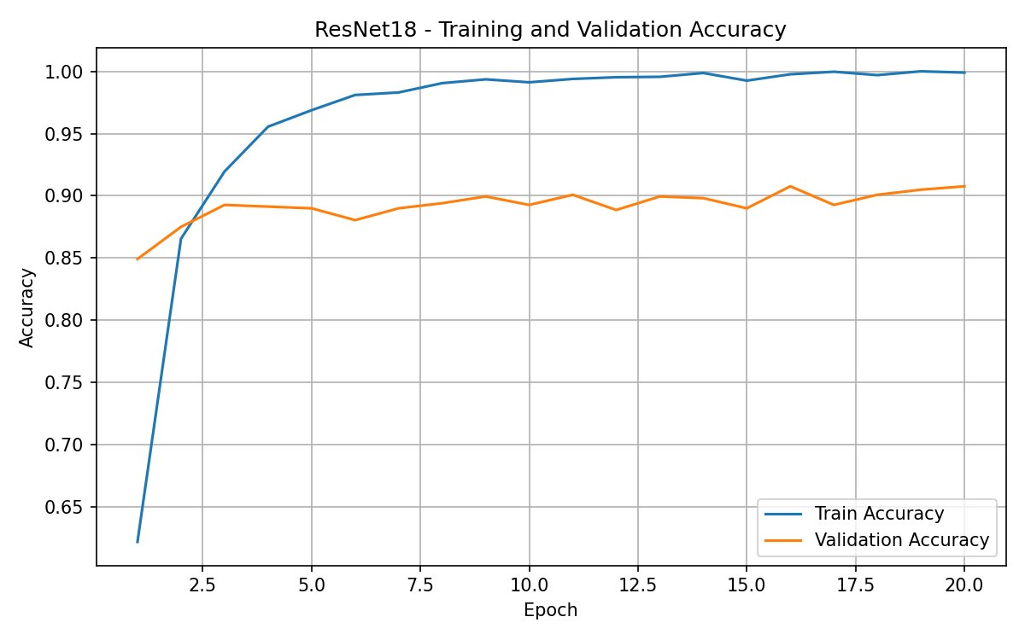
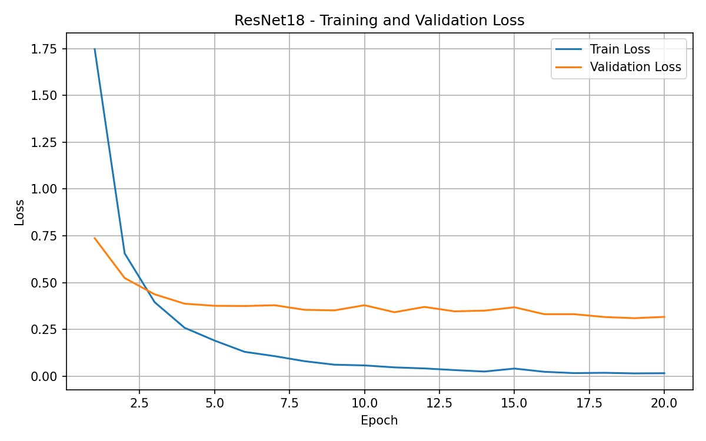
ResNet18 — Training Curves
20 epochs · layer-4 fine-tuning · pre-trained ImageNet

Slide 9
ResNet18 — Results
20 epochs · layer4 + fc fine-tuning · ImageNet
90.76%
86.15%
4.61 pp
Best Val Accuracy
(epoch 20)
Test Accuracy
(precision 86.43% / recall 86.05%)
Generalization Gap
(low overfit)
Training Curves — Observations
Ablation Experiments
Transfer learning converges significantly faster than CNN
Frozen backbone prevents overfitting in early epochs
Test/val gap 4.61 pp — low overfitting
Fine-tuning last layers yields best generalization
Pre-trained features transfer well to pet breed classification
Configuration
Test Acc
Note
Baseline (20 ep.)
86.15%
✅ Best
EXP1 — lr=1e-3, bs=16
82.09%
lr too high
EXP2 — lr=1e-3, bs=32
83.73%
same lr
EXP3 — lr=5e-4, bs=16
84.44%
lr too low
EXP4 — layer3+4+fc
82.72%
more layers
🔑 Reducing lr from 1e-3 to 1e-4 was the single biggest gain. Layer4+fc strategy best balances accuracy and stability.

Slide 10
ConvNeXt-Tiny — Architecture
Pre-trained on ImageNet-1k — fine-tuned on Oxford Pet
Input
256×256
Stages 1–3
frozen
Stage 4
frozen
Classifier
fine-tuned
GAP
+LayerNorm
FC
37 classes
Training Configuration
Architecture Detail
Optimizer
AdamW (lr=5e-4, weight_decay=1e-4)
ConvNeXt Block
DwConv→LayerNorm→Linear→GELU
Schedule
ReduceLROnPlateau
4 stages
96→192→384→768 ch.
Epochs
20
GAP
GAP → LayerNorm → Linear(768,37)
Batch size
24
Dropout
Stochastic depth + label smoothing
Loss
CrossEntropy
Output
Linear(768, 37) — last block unfrozen
Regulariz.
Label smoothing=0.05, dropout=0.1
Params
~28.6M total / last_block strategy

Slide 11
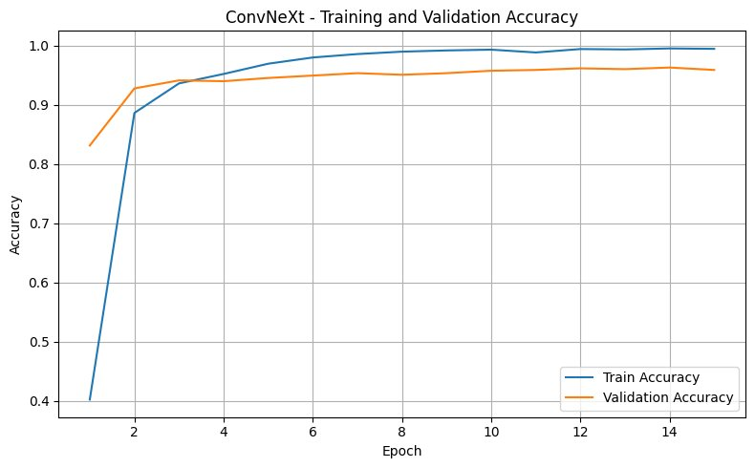
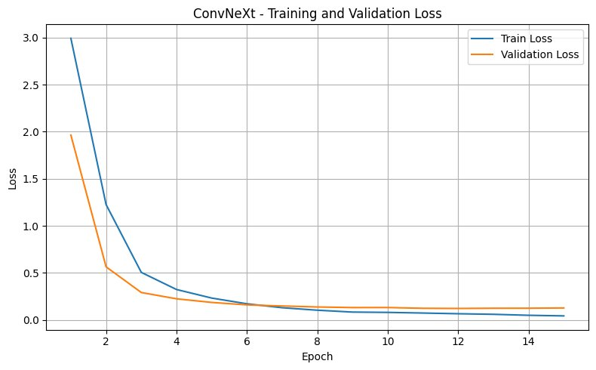
ConvNeXt-Tiny — Training Curves
15 epochs · last-block fine-tuning · pre-trained ImageNet-1k

Slide 12
ConvNeXt-Tiny — Results
20 epochs · last_block fine-tuning · ImageNet-1k
96.88%
94.06%
2.82 pp
Best Val Accuracy
(epoch 20)
Test Accuracy
(precision 94.18% / recall 94.00%)
Generalization Gap
(very low overfitting)
Training Curves — Observations
Ablation Experiments
ConvNeXt converges quickly due to strong pre-training
Stochastic depth regularization reduces overfitting
Test/val gap 2.82 pp — very low overfitting
Modern CNN architecture generalizes well on fine-grained task
Best tradeoff between accuracy and training cost
Configuration
Test Acc
Note
Exp2 — lr=5e-4, img=256, ep=20
94.06%
✅ Best
exp1 — lr=5e-4, img=224
93.30%
smaller img
exp3 — classifier only
92.48%
head only
exp4 — last_two_blocks
93.87%
💀 more lyr
exp5 — full finetune
92.37%
all layers
🔑 256px input gave the largest accuracy boost (+0.76% test). last_block strategy avoids overfitting efficiently.

Slide 13
ViT Base Patch16-224 — Architecture
Vision Transformer pre-trained on ImageNet-21k
Input
224×224
Patch Embed
196 tokens
Blocks 1–11
frozen
Block 12
fine-tuned
[CLS] Token
+ Head
FC
37 classes
Training Configuration
Architecture Detail
Optimizer
AdamW (lr=1e-4, wd=5e-4)
Transf. Block
MSA + LayerNorm + MLP (GELU)
Schedule
ReduceLROnPlateau
12 Enc. layers
768 hidden, 12 heads, patch=16
Epochs
25
GAP
[CLS] token → Linear(768, 37)
Batch size
16
Dropout
Attention dropout (last block only)
Loss
CrossEntropy
Output
Linear(768, 37) — new classifier
Regulariz.
Label smoothing=0.05, last_block
Params
~86M total / last_block strategy

Slide 14
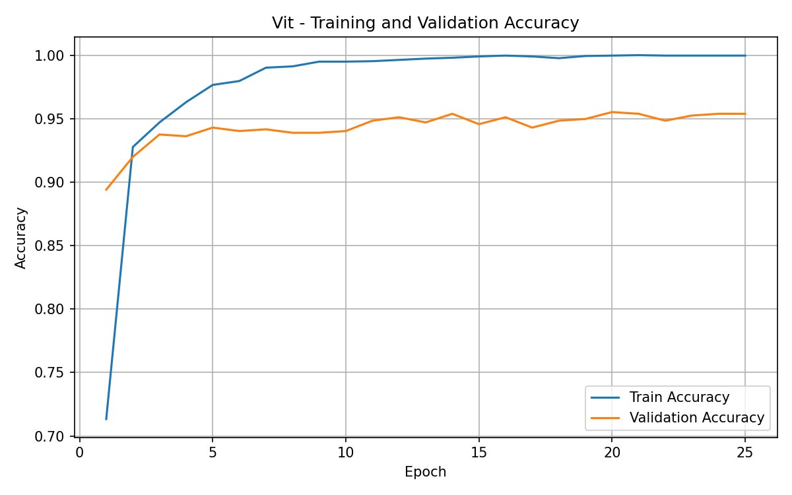
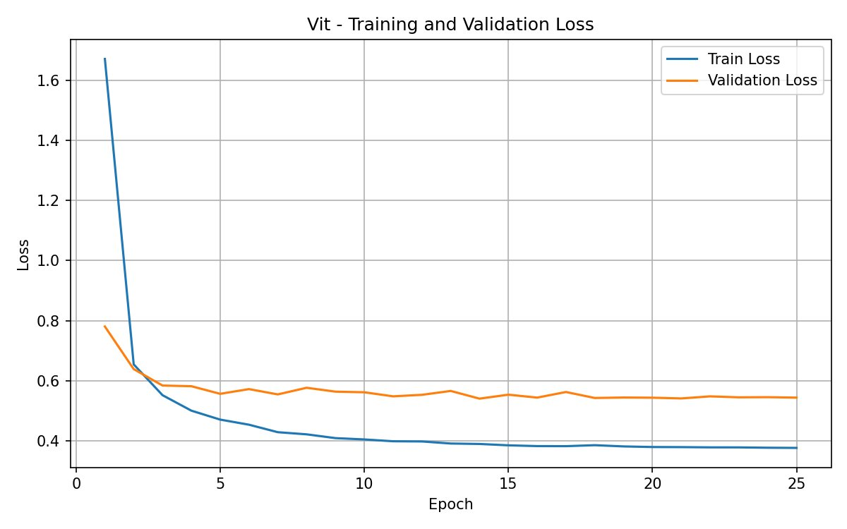
ViT — Training Curves
25 epochs · last-block fine-tuning · pre-trained ImageNet-21k

Slide 15
ViT — Results
25 epochs · last_block fine-tuning · ImageNet-21k
95.52%
93.35%
2.17 pp
Best Val Accuracy
(epoch 25)
Test Accuracy
(precision 93.52% / recall 93.31%)
Generalization Gap
(very low overfitting)
Training Curves — Observations
Ablation Experiments
ViT achieves highest overall accuracy with enough epochs
ReduceLROnPlateau handles lr decay effectively
Test/val gap 2.17 pp — very low overfitting
[CLS] token captures global context ideal for breed classification
Configuration
Test Acc
Note
exp3 — last_block (25 ep.)
93.16%
✅ Best
exp1 — classifier, lr=1e-3
92.29%
head only
exp2 — classifier, strong aug
91.91%
strong aug
exp4 — last_two_blocks
92.89%
2 blocks
exp5 — full_finetune
92.83%
all layers
🔑 last_block fine-tuning gives best test accuracy. Classifier-only already reaches 92.29% — a strong baseline.

Slide 16
Results Comparison
Among all evaluated models, ConvNeXt Tiny achieved the strongest overall performance on the Oxford-IIIT Pet dataset.
94%
94%
94%
2.8%
Test Accuracy
(best model)
Macro precision
Macro recall
Validation–test gap
(best model)
Key Findings
Model Summary
ConvNeXt Tiny achieved the best overall performance and the strongest accuracy-to-training-cost trade-off.
ViT and ConvNeXt consistently outperformed ResNet18 and the baseline CNN in accuracy, precision, and recall.
Classifier-only fine-tuning already achieved near-optimal performance, with limited gains from full fine-tuning.
Batch normalization was critical for stable CNN training, while removing it caused severe performance degradation.
Pretrained models showed better robustness and generalization with lower sensitivity to hyperparameter changes.
Model
Best Test Acc
Params
ConvNeXt-Tiny
94.06%
~28.6M
ViT Base Patch16 224
93.16%
~86M
ResNet18
85.91%
~11.7M
Baseline CNN
62.25%
~0.5M
🔑 Transfer learning models dramatically outperform the CNN baseline across all evaluation metrics.

Slide 17
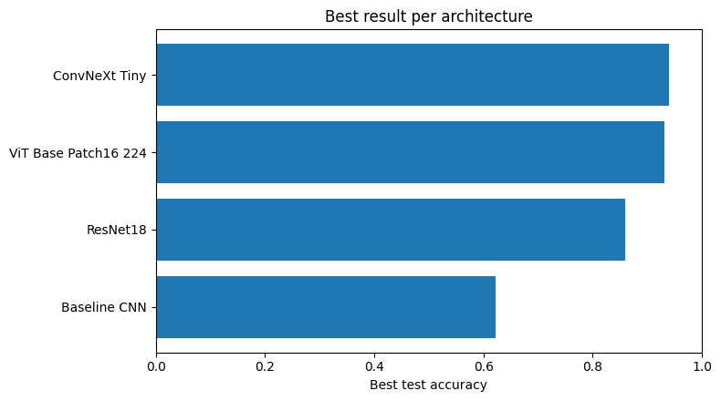
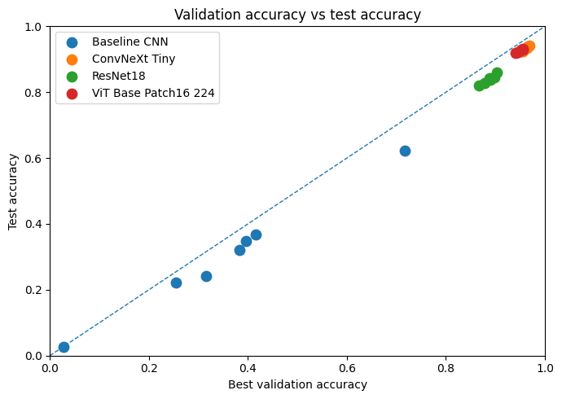
Model Performance Comparison
Best result per architecture
Validation vs Test Accuracy
Ranked by test accuracy (all experiments)
Val accuracy vs test accuracy scatter per model
🔑 Transfer learning models dramatically outperform the CNN baseline. ConvNeXt Tiny and ViT models achieved the highest and most stable accuracies, while the baseline CNN showed comparatively lower performance.

Slide 18
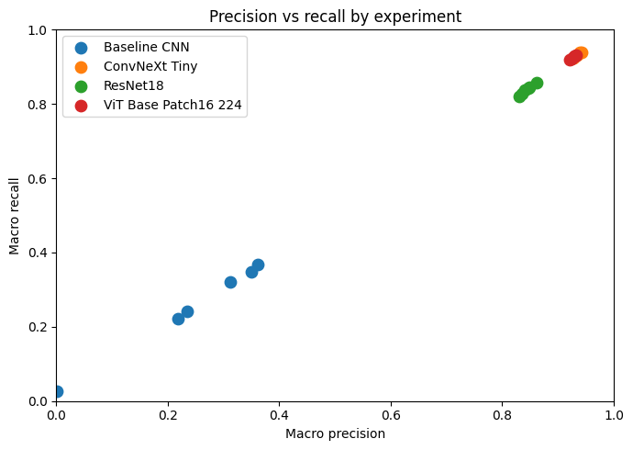
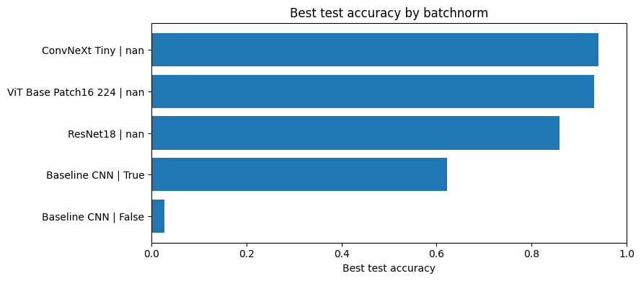
Classification Performance & Training Stability
Precision vs Recall
Best Test Accuracy by Batch Normalization
🔑 ConvNeXt Tiny and ViT achieved the highest and most balanced precision–recall performance, indicating strong and consistent classification capability. The baseline CNN showed substantially lower precision and recall across experiments.
🔑 Batch normalization significantly improved the baseline CNN performance and training stability. Pretrained architectures maintained high accuracy consistently due to their optimized built-in normalization mechanisms.

Slide 19
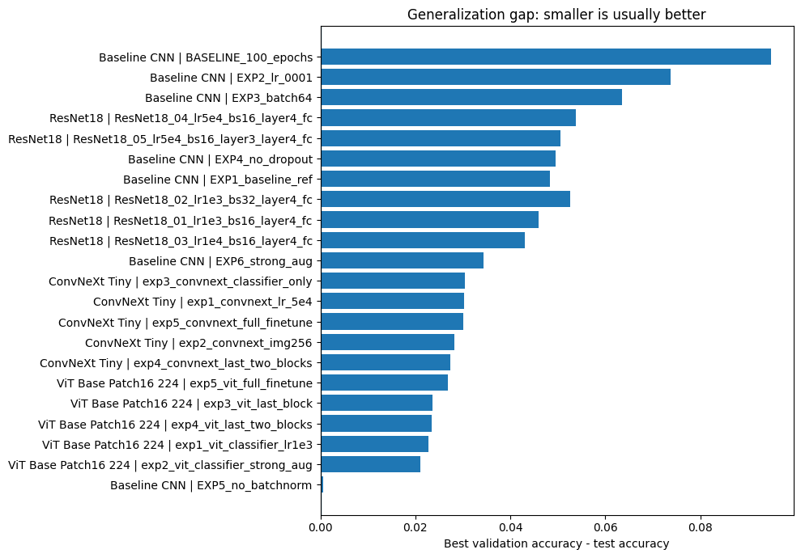
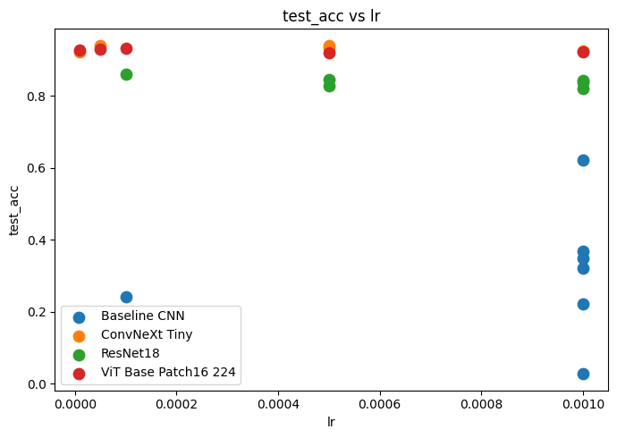
Generalization & Robustness
Generalization gap comparison
Learning rate sensitivity
Train/val accuracy gap for best run of each model
Test accuracy vs learning rate across all models
🔑 Smaller generalization gaps were observed for ViT and ConvNeXt experiments, indicating better generalization from validation to test data. Baseline CNN models showed larger gaps, suggesting higher overfitting and less stable performance.
🔑 ConvNeXt Tiny and ViT models maintained consistently high test accuracy across different learning rates, showing strong robustness to hyperparameter changes. In contrast, the baseline CNN was highly sensitive.

Slide 20
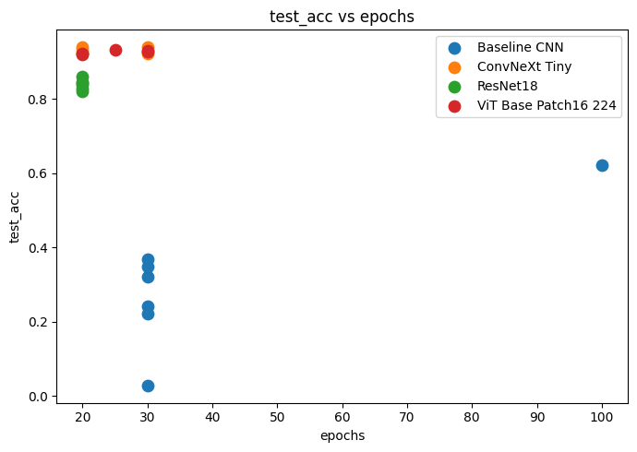
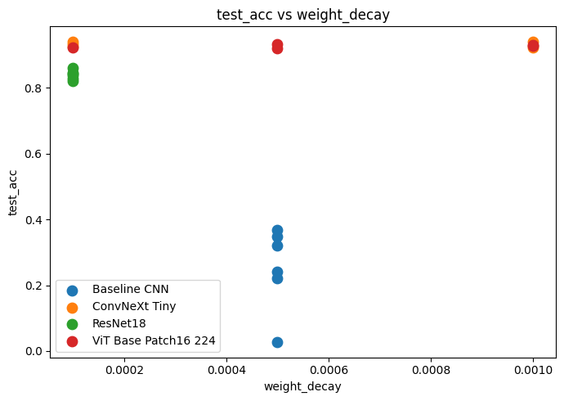
Hyperparameter Exploration
Epoch count impact
Weight decay impact
Test accuracy vs number of training epochs
Test accuracy vs weight decay coefficient
🔑 ConvNeXt Tiny and ViT achieved consistently high test accuracy across different epoch counts and weight decay values, demonstrating strong robustness with minimal hyperparameter sensitivity. In contrast, the baseline CNN showed unstable performance and required more careful tuning to achieve reasonable results.

Slide 21
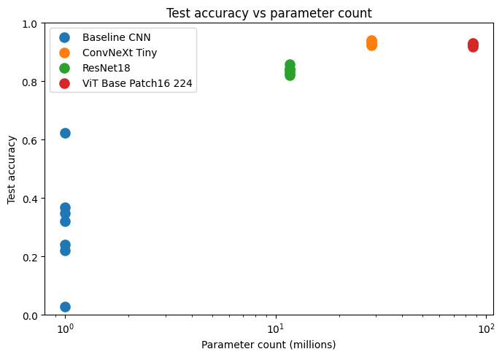
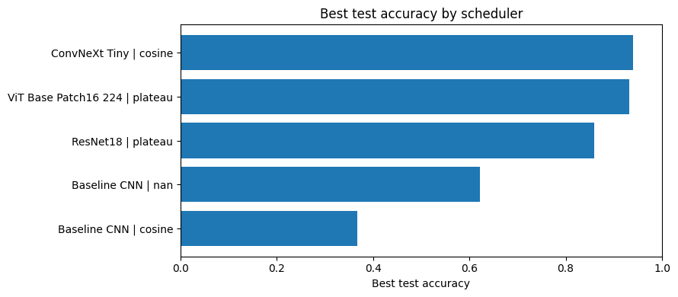
Hyperparameter Exploration (cont.)
Model size vs accuracy
Scheduler comparison
Parameter count vs test accuracy for all models
Test accuracy with different LR schedulers
🔑 Larger pretrained models generally achieved higher test accuracy, but the performance gain became marginal at very high parameter counts. ConvNeXt Tiny provided the best accuracy–efficiency trade-off, while appropriate learning rate scheduling further improved training stability and final performance.

Slide 22
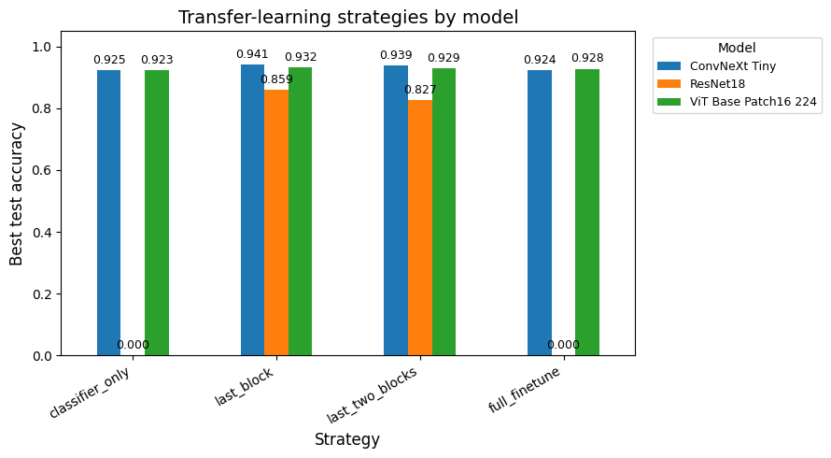
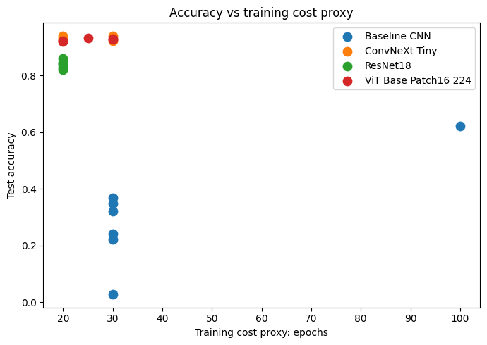
Transfer Learning Analysis
Fine-tuning strategy and training cost
Transfer learning strategy comparison
Accuracy vs training cost
Classifier-only vs full fine-tuning accuracy
Test accuracy vs training time (epochs x batch time)
🔑 Classifier-only fine-tuning offers an excellent accuracy-to-cost tradeoff. More extensive fine-tuning (last blocks or full fine-tuning) produced only marginal accuracy improvements, showing that pretrained feature representations were already highly effective for the dataset.

Slide 23
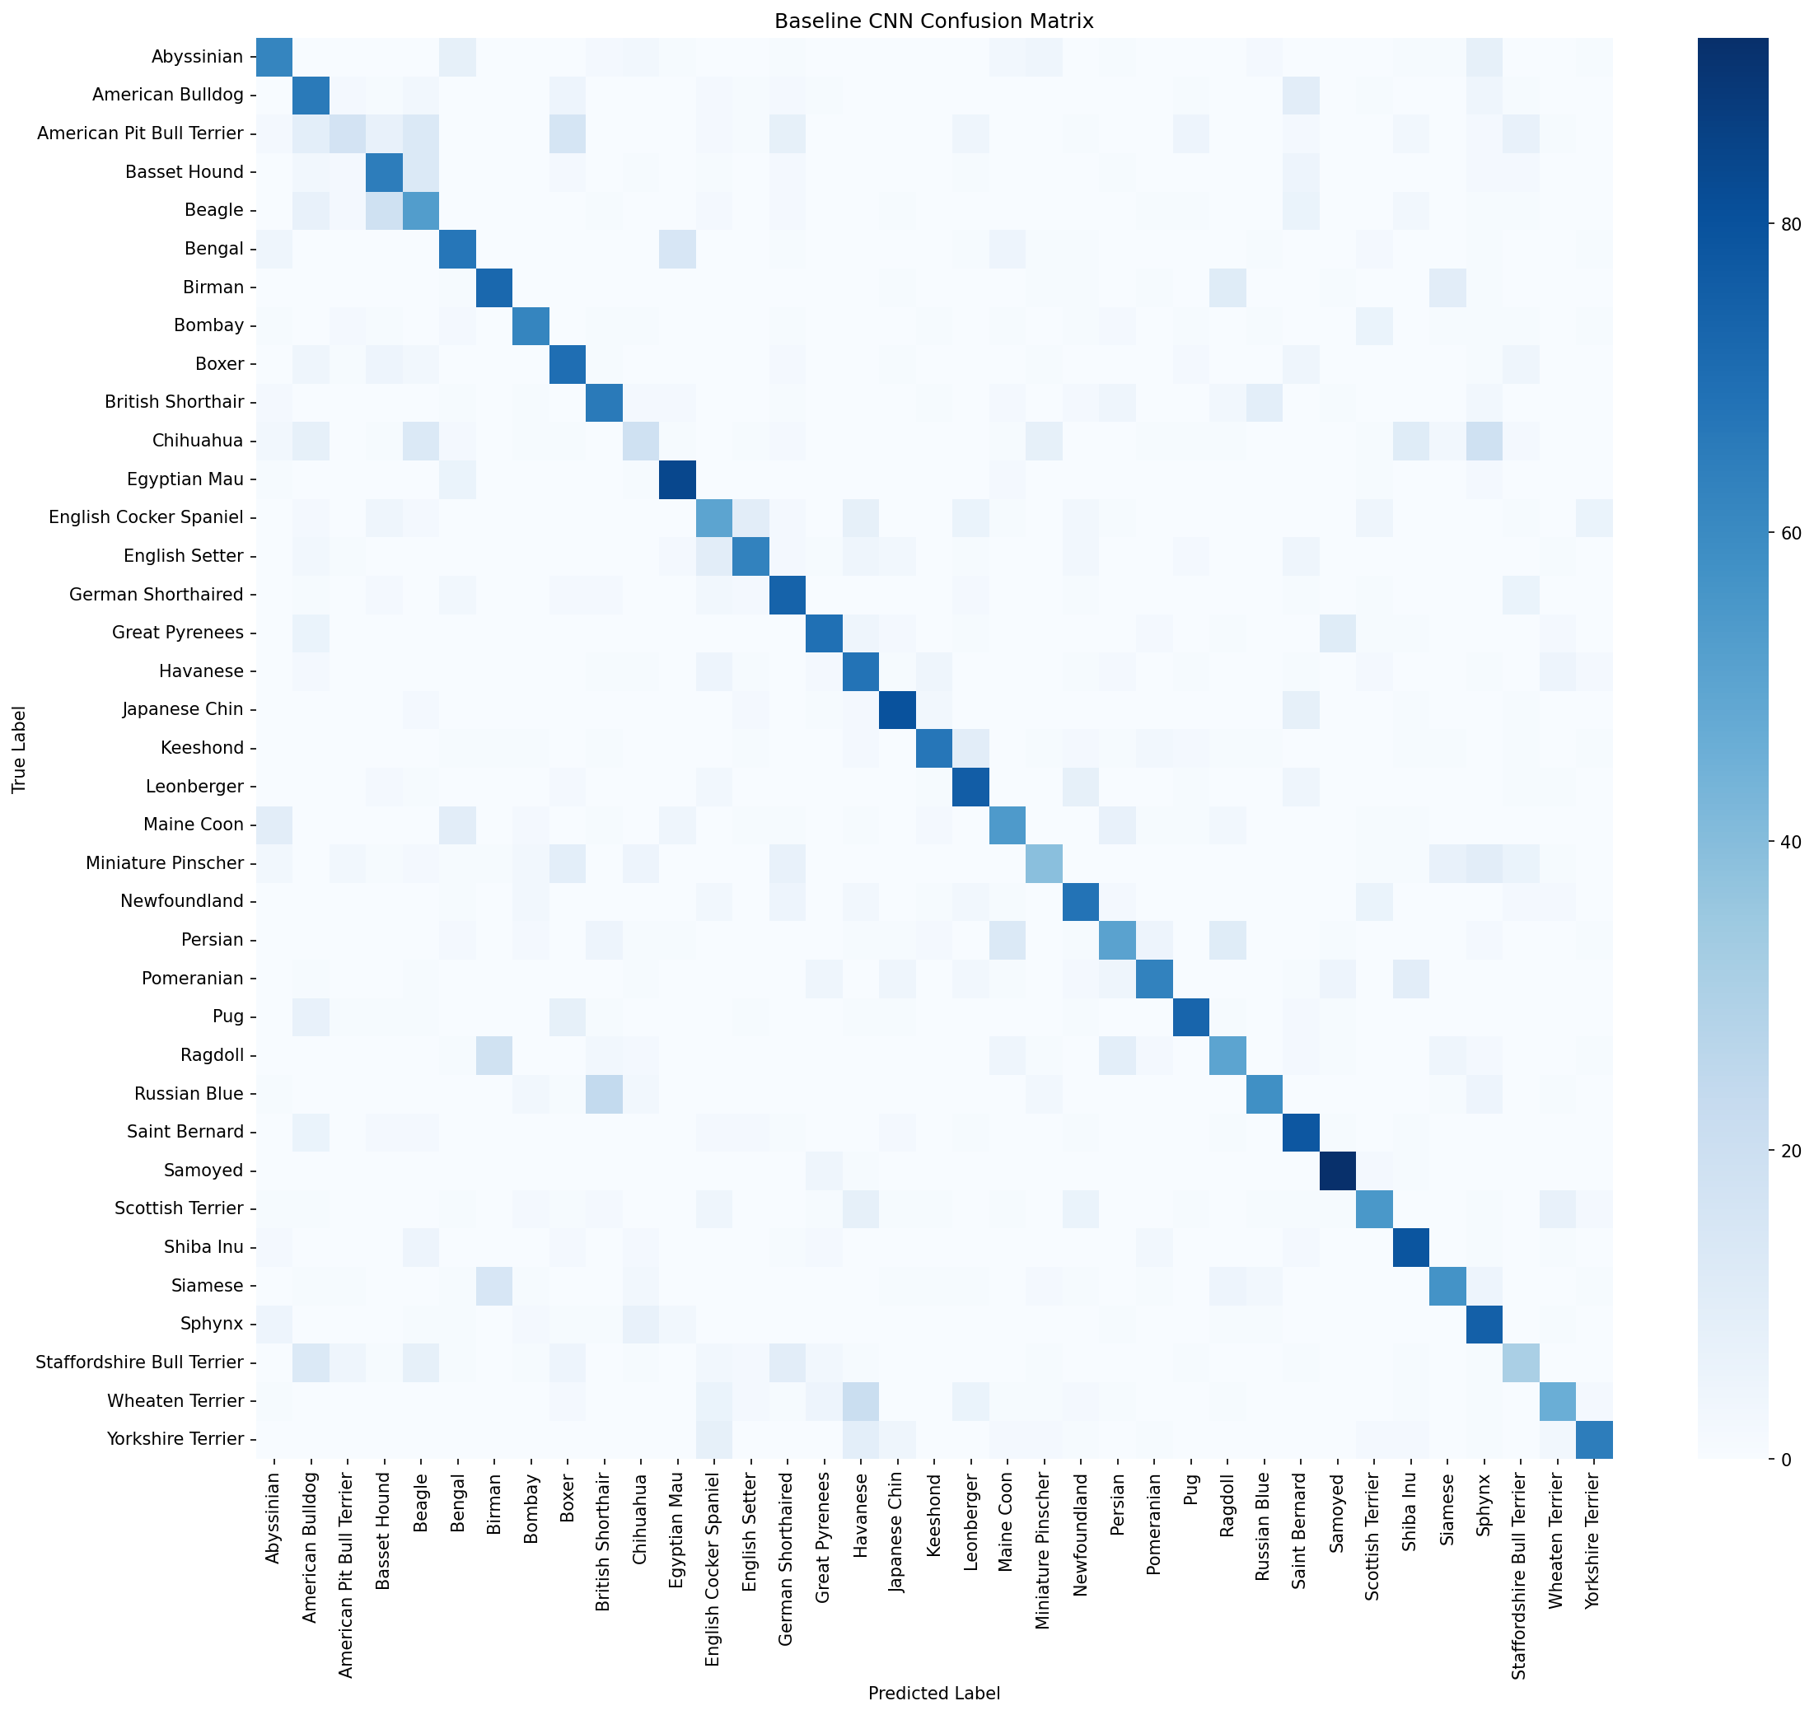
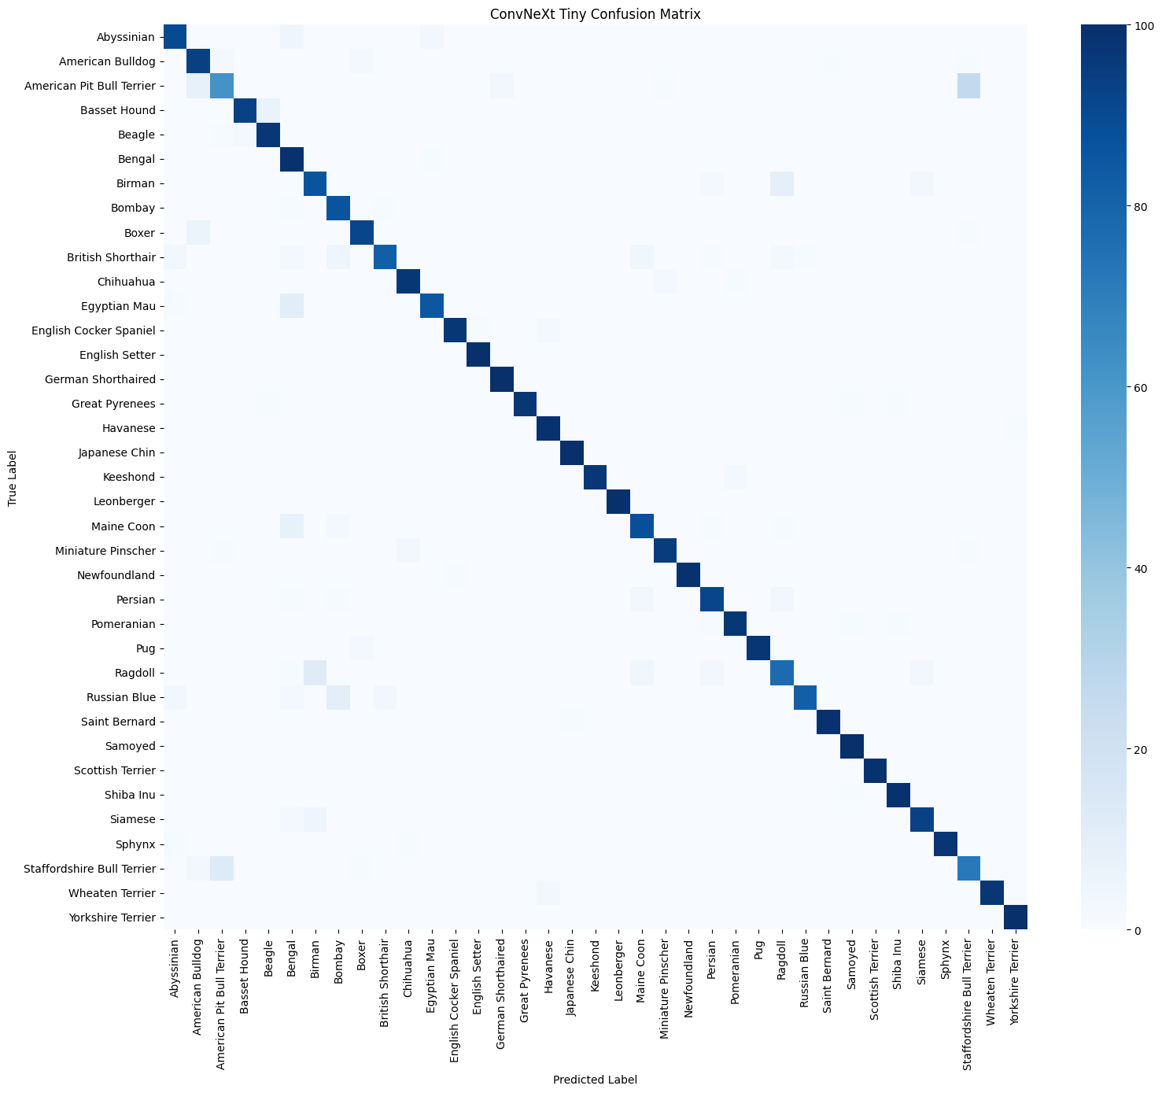
Confusion Matrix (Baseline CNN vs ConvNeXt)

Slide 24
Classification App — Architecture
Streamlit web app • 4 selectable models • top-3 predictions with confidence
Inference Pipeline
Upload Image
JPG / PNG
Preprocess
Resize + Normalize
Model Inference
CNN/ ResNet / ConvNeXt / ViT
Softmax
Probabilities
Top-3 Output
Breed + Confidence
Tech Stack
Key Features
Frontend
Streamlit
✓ Multi-model selector in sidebar (CNN, ResNet, ConvNeXt, ViT)
DL / Models
PyTorch, torchvision, HuggingFace
✓ Top-3 predictions with confidence progress bars
Models
CNN, ResNet18 ,ConvNeXt-Tiny, ViT-B/16
✓ Dog vs Cat label automatically resolved per class
Image Lib
Pillow (PIL)
Caching
@st.cache_resource
✓ Per-model image transforms (size + normalization)
✓ Cached model loading — no reload between predictions
✓ class_names.json for human-readable class mapping

Slide 25
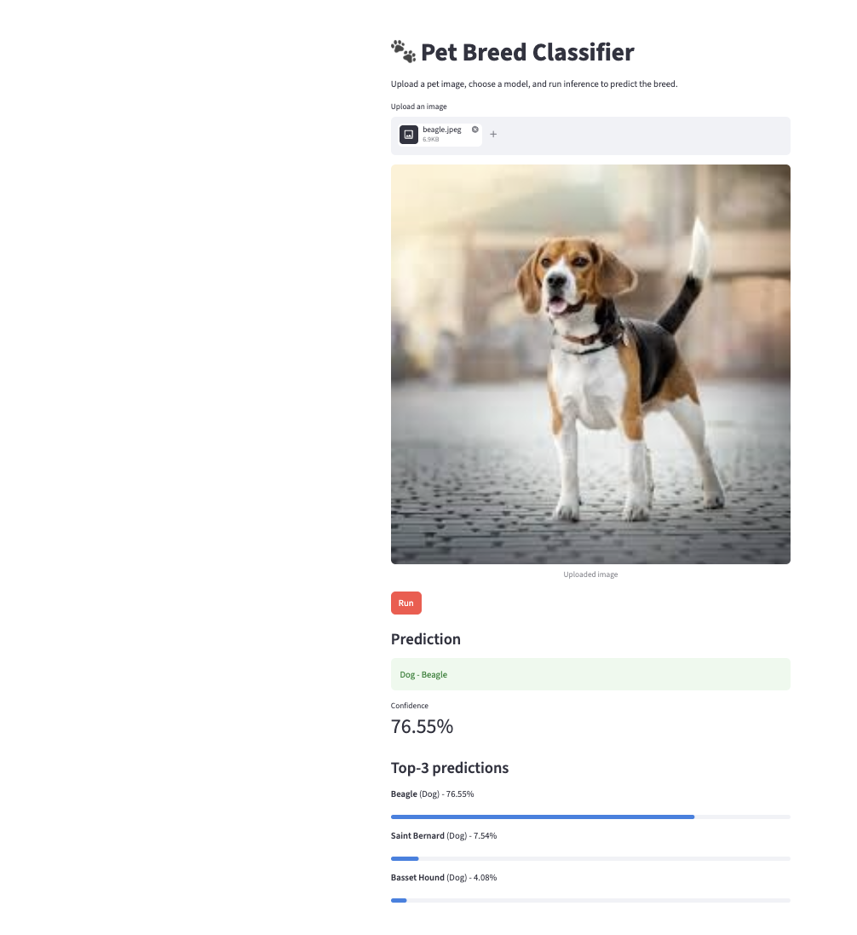
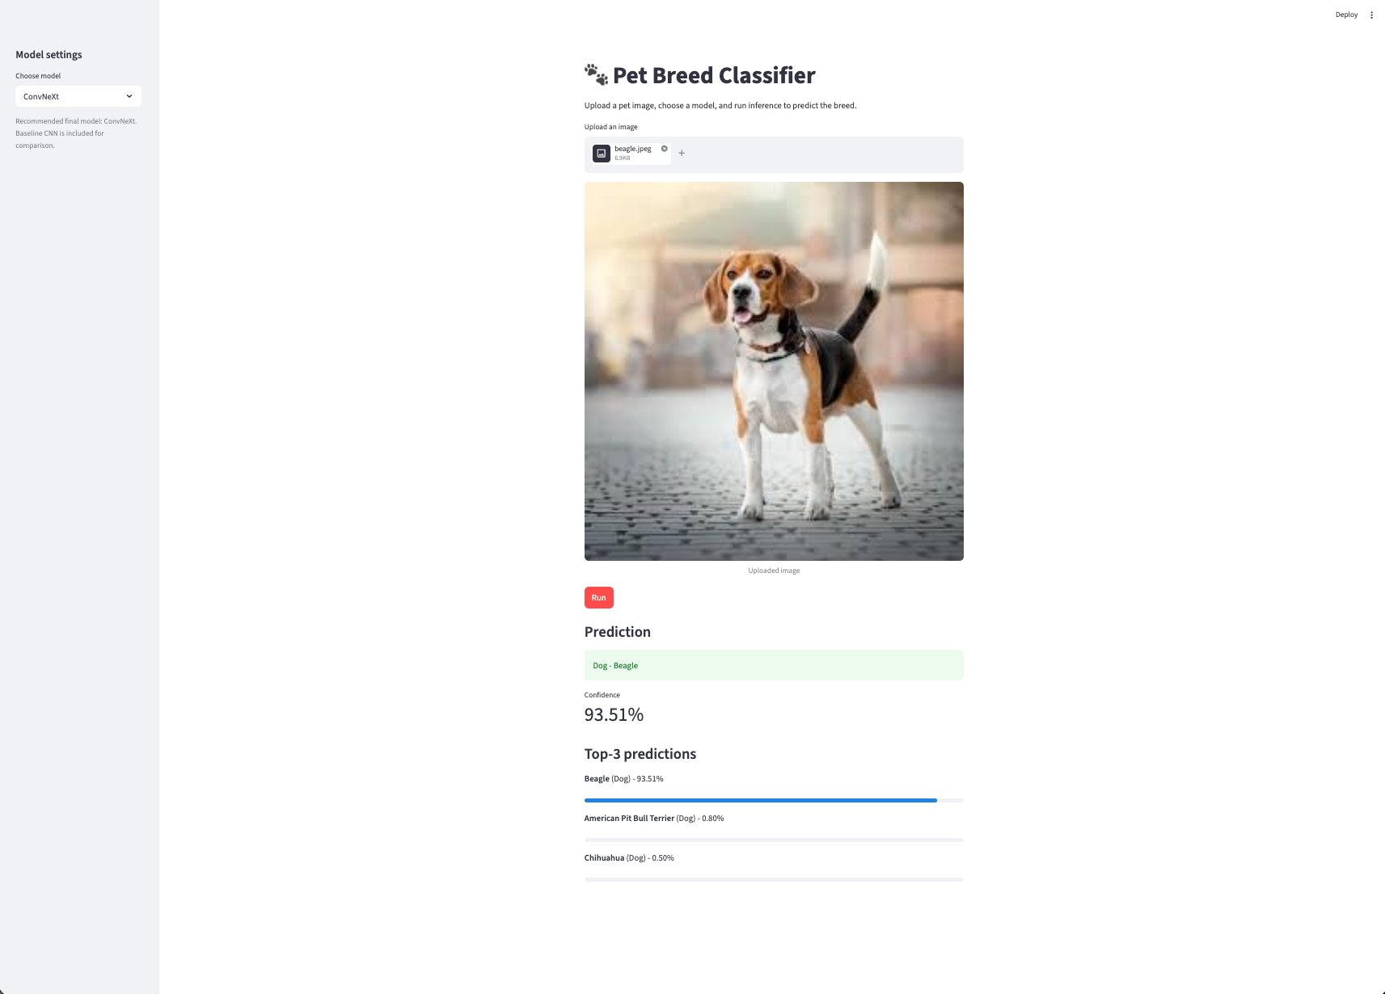
Classification App — Live Demo
Baseline CNN vs ConvNeXt model • Input: Beagle

